Slide 1
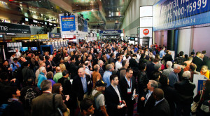
2023 Convention Center & Event Producer
Industry Outlook
Michael Hughes
Managing Director Research & Consulting

Slide 2
Contents
I. Insights
II. Convention Center Survey Data
III. Event Producers & Meeting Planners
IV. Conclusion – Q&A

Slide 3
About the Study
Two surveys conducted in Q2 of 2023 – Convention Center management executives (45 responses), conducted with the Convention Center Consortium; and a diverse group of Event Producers and Meeting Planners (over 100 responses)
Key themes
Strong rebound overall, yet mixed performance for different types of events
Rebound has surprised the industry – although attendees and corporations consistently said in 2020 to 2021/2022 they would come back to events quickly
2024 should be the true “back to normal” year
What’s changed: inflation, staffing challenges, booking shifts…

Slide 4
Convention Center Survey Data

Slide 5
About the Respondents: Destination size and center gsf
Destination size
Convention Center size

Slide 6
Best performing client and group segments
Associations are the key industry group – but sporting events and competitions have become critical

Slide 7
Attendance recovery vs. 2019
Convention Center Estimates
2022
2023
92%
71%
Average all responding venues, YTD to May/June each year. 2024 should be the “full recovery” year. These statistics for 2023 are a little bit higher than to what event producers and meeting planners have said in studies.
7

Slide 8
Event Producer reported attendance rebound vs. 2019
Q2 2023
Q3 2022
84%
Q2 2022
75%
Q4 2021
Q3 2021
68%
66%
Q1 2022
59%
57%

Slide 9
The industry rebound has been much better than expected
The pace of recovery has surprised 83% of convention center executives
Convention Center Business Recovery Performance Compared to Pandemic Expectations

Slide 10
2023 venue total bookings and gross revenue vs. 2019
Good recovery on attendance – yet revenue and bookings are still behind 2019
Gross Revenue compared to 2019 % of Convention Centers
Total Bookings compared to 2019
% of Convention Centers
66%
52%

Slide 11
Venue strategy, business model and pricing changes
Centers have been reassessing the business – and making changes
 | %
Increased other venue services pricing | 70%
Increased our pricing for exhibition halls and major event spaces | 48%
Changed our bookings and marketing focus, orientation to certain types of events | 27%
Started to offer important new services or lines of business | 18%
Changed formal relationship with CVB/DMO/city-regional destination marketing partner | 12%
Changed critical services provider partner(s) such as F&B or telecommunications | 12%
Partnered with event producers to launch or co-own events, or cost/profit/risk share | 9%
Other important partnership(s) | 9%

Slide 12
Impact of political and social activism on bookings
Broadly, there are three types of destinations – those losing some business and not being considered; cities winning this lost business; and a third group that’s neutral
 | %
Yes, at least one client group has moved their event out of our venue or destination | 18%
Yes, at least one client group or event has moved their event to our venue or destination | 27%
Yes, we know at least one client group or event has excluded our venue or destination during the site-selection process | 33%
No, but at least one existing client or group has raised issues/concerns and/or is considered moving or excluding our venue/destination | 9%
No issues related to social activism or legislation have impacted bookings/interest levels | 36%

Slide 13
Venue technology investment and resources focus
The three key tech investment areas are security, telecom/internet and digital signage
 | %
Venue safety and security | 56%
Telecommunications, internet capacity and services | 41%
Digital signage and communications systems | 41%
Food and beverage-related (such as online ordering, self-service, etc.) | 28%
IT network security, cyber security | 25%
Overall venue operations management and communications technology | 22%
Electrical, HVAC and/or lighting | 22%
Sales and marketing | 22%
Audio-Visual | 16%
Event production services | 9%
Human resources, staffing software and platforms | 9%
Video, streaming, broadcasting services or studios | 6%

Slide 14
Spaces and areas that most need investment
Technology, exhibit halls and signage are the top three areas in need of upgrades

Slide 15
Sales & Marketing – what’s working
Enhanced partnerships, communication with DMO/CVB partners
More collaborative and creative bids with DMO/CVB and hotels
Working more closely with in-building partners on bids
Sales missions, FAMs and events
Better client and group targeting
Re-engaging at industry events
15

Slide 16
Innovations
After an innovation wave in 2021 and 2022, there’s been less this year
Common examples:
Digital signage
F&B formats
Cashless points of sale
Management and marketing software
Staff management changes, restructuring

Slide 17
State of hotels in your markets
High rates and occupancy – and low staffing levels
Top Five Hotel Trends | %
Charging consistently high room rates | 63%
Experiencing staffing issues, lack of staff or quality issues, etc. | 63%
Generally experiencing high occupancy on the weekends | 60%
Generally experiencing high occupancy on the weekdays | 50%
Are “difficult” to work with from venue and event producer perspectives | 27%

Slide 18
WFH and hybrid work impact on event attendance
Most industry professionals are unsure how WFH is impacting events, but some centers are seeing companies using events to bring dispersed groups together – yet some think WFH is a negative

Slide 19
New types of events, clients and formats
Over 40% of centers are booking “new” types of events and groups
Common examples:
Gaming and esports
Youth sports and competitions
Corp. meetings to bring teams together
Art, entertainment and consumer-oriented;
Pop culture events
Special events, activations within events

Slide 20
How key clients are changing – themes
Reduced budgets, price sensitivity, negotiating more
Concerned about inflation
Late attendance bookings, some events still recovering total attendance #’s
Mixed client basses – some events are strong, and others are weak
Compressed event planning schedules
Changed or reduced staff
20

Slide 21
How key clients are changing – quotes
“Almost all are looking for bigger discounts and more free stuff.”
“Attendance is still building back, behind on booking pace for larger conventions.”
“Budgets are smaller.”
“Planning windows have shrunk, and gathering event information has been a struggle whether due to staffing changes or new meeting formats.”
“Some are growing every year and others have decreased in attendance.”
“Negotiations are more difficult due to major budget restraints.”
“They were changing however, as things return, they seem to be going back to how things were.”
21

Slide 22
Importance of sustainability and net carbon emission reduction
Sustainability continues to become more important for venue and clients

Slide 23
Importance of maintaining safety/security procedures/protocols
The findings raise the question: Is this post-pandemic “health” related – or more about “security”?

Slide 24
Inflation is one of the major issues and challenges
Inflation is the #1 rated risk to growth by event producers and meeting planners
Common examples:
Labor
F&B
Utilities, energy
Contractors and service providers
“F&B prices have seen several rate increases over the last 3 years.”
“Labor, utilities, contractors – pretty much everything across the board have experienced increases.”

Slide 25
Specific pricing increases by convention centers
Parking, F&B, labor and AV have seen the largest price increases
Average Convention Centers Pricing Increases

Slide 26
Impact of AI on the convention center industry, quotes
It’s too early to tell…
“AI could help reduce low value work and save time and labor.”
“I feel that AI could enhance the way us humans interact with our clients and/or potential clients through social media marketing. AI can never take the place of the desire to seek human interaction and networking. We can work with AI to create more powerful platforms in all aspects.”
“I feel it will benefit this industry in many areas. Hospitality industry is gray industry meaning no event is the same, so I don't see AI replacing team members but making things more efficient like AI cleaning floors, etc.”
“Replace marketing positions.”
“Unsure.”

Slide 27
Event Producers

Slide 28
Event Producers: Investments and risks
Overall, event producer and meeting planner performance has been good but mixed. The return to in-person has been robust but each event, sector and organization is different – and there are challenges.
How can centres help with attendance marketing and attendee services? Education and experiential elements are also key.
Much of the inflation is “on-site” venue-related and working with hotels is challenging – and a sign of “normality” is event competition is increasing somewhat again.
Where Event Producers are Investing
Growth Risks

Slide 29
Event Producers: Where they want venues to invest, add value
Event Producers: Where Venues Should Invest
Event Producers: How Venues Can Add Value
Continue to add more attendee-focused amenities, services and areas
Contain costs, more visibility, discounts (especially technology, AV and F&B)
More timely responses to RFPs
Be customer service centric
Focus on sustainability
Better communicate venue news, new services and staff changes
Take more of a partnership approach
Increase staffing

Slide 30
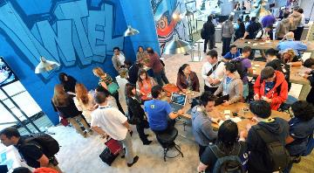
Event Producers: % Planning to launch new events in next 2 years
A large segment of event producers, but still under half, say they plan to launch a completely new in-person event over the next two years. Some are taking risks in a good economy; others are responding to specific industry trends – and others are trying to adapt and survive.
Over four out of ten event producers expect to launch an entirely new event within the next two years

Slide 31
Event Producers: Are attendees registering closer to event dates?
Just under three-quarters of the respondents say, their attendees are registering closer to the event dates.
Is a meaningful to large segment of your attendees registering closer to event dates?

Slide 32
Event Producers: How WFH/hybrid work impacts attendance
Most event producers are unsure how work-from-home and hybrid work has impacted attendance. 30% said “no change” and 14% are “unsure.”
WFH and Hybrid Work Impact on Attendance

Slide 33
Conclusion

Slide 34
Convention Centers: Industry outlook next three+ years
Convention center executives are confident about the next few years

Slide 35
Conclusion
Strong rebound overall – but mixed performance for different types of events
What’s changed: inflation, staffing challenges, booking shifts, social activism/politics
Sports and competitions continue to be a critical booking category
How long will inflation last?
Need for continued investments with technology a focus – and a mini-expansion wave building
2024 should be the true “back to normal” year

Slide 36
Convention Center executive quotes on the industry outlook
“At the rate buildings are expanding someone is painting a positive outlook.”
“Cost and labor concerns will remain priorities.”
“Depending on the event/segment I believe we will continue to see declining in-person attendance as many segments are facing economic pressure. I also feel like the pandemic has given people an excuse to not attend live events.”
“Higher pay for the front lines positions that are hard to staff and make the biggest impact on customer experience. People have realized the importance of gathering together so overall I think the pandemic spurred on growth in the events industry. We've recovered stronger than we were pre-pandemic.”
36

Slide 37
Convention Center executive quotes on the industry outlook
“I think the trend will go less association/corporate and more social/sports related.”
“Security, theft, homelessness etc. is a big concern. We see 20 good tweets go unnoticed and the 1 negative one gets headlines.”
“Sustainability, legacy and impact of business events will make events even more relevant and important but will also challenge us to think differently.”
“The face-to-face need to interact is still strong.”
37

Slide 38
Convention Center executive quotes on the industry outlook
“There is a great deal of movement happening in our industry, so it’s tough to tell everything right now.”
“Travel has become somewhat a challenge due to less flights being offered and ticket price increases.”
“Work from home are making Annual Conventions a ‘must go to’ for the opportunity to see colleagues in-person”
38

Slide 39
“The purpose of events is being questioned…
The best events will thrive.”
39

Slide 40
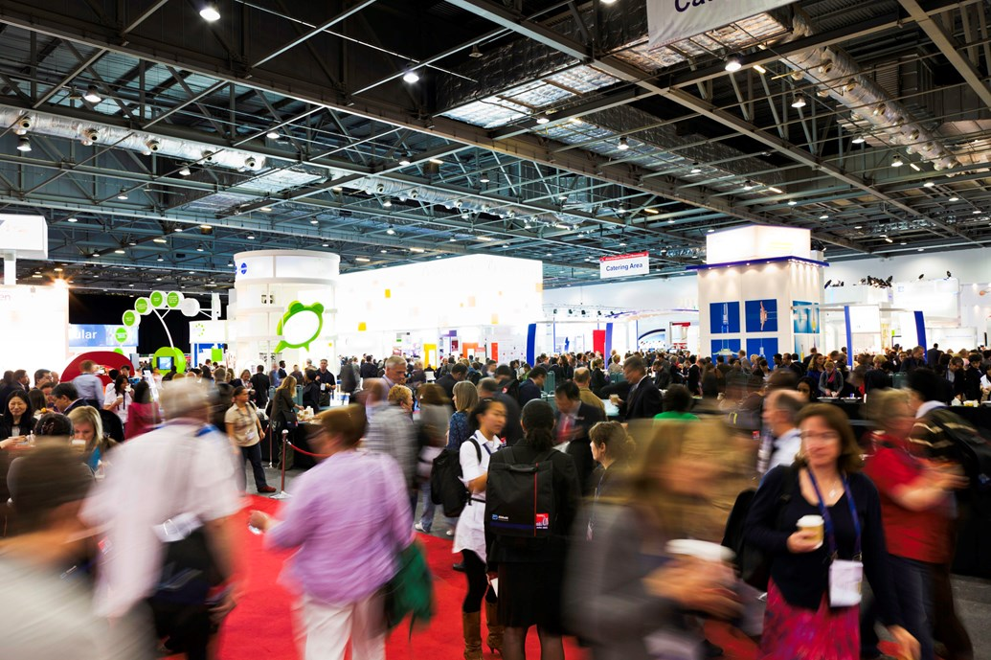
Q&A

